Slide 1
EVENT-BASED DATA ASSURANCE
WORKSHOP #5: ONTOLOGY (4)
4th March 2020

Slide 2
Agenda
Introductions 13.00 – 13.15
Background – why are we here? 13.15 – 13.30
Standards – what do we mean by an “Event”? 13.30 – 14.00
Ontology – what does an OEF ecosystem “do”? 14.00 – 15.15
Target use case – importing wine into the UK 15.15 – 15.45
Questions / any other business 15.45 – 16.00

Slide 3
Workshop schedule
W/s | Date | Deliverable | Agenda | Attendees
KO | 29/01 1-4pm | Common understanding | Questions Problem statements Expressions of interest | FB Technical Architect HMRC Technical Architect HMRC Innovation Lead
#1 | 05/02 1-4pm | Standards | Standards to implement and communicate shared knowledge base used in event-based data assurance
#2 | 12/02 1-4pm | Metadata model | Reasoning models for data assurance Classification Events Chains / sequences / methods Actors (e.g. source of events) Relationships (e.g. linking IDs) Supporting metadata Schema / headers Mandatory Optional
#3 | 19/02 1-4pm
#4 | 26/02 2-5pm
#5 | 04/03 1-4pm | Expert input | Expert assessment of proposed standards and metadata model | Representatives of Inrupt, Oxford Semantic Tech
#6 | 11/03 1-4pm | Rules of engagement | Boundary of open alliance Scalable / mutual contractual agreements for value exchange Value exchange mechanisms Publication of / subscription to events Permissioning (including consent) Use of standards and metadata model Governance | HMRC Innovation Lead HMRC Stakeholders x2 GDS representative(s)
#7 | 18/03 1-4pm
#8 | 25/03 9am-12

Slide 4
Section 1
Background

Slide 5
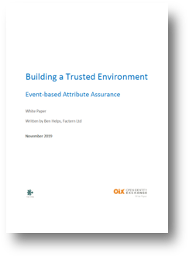
We ran an OIX Discovery Project over the summer of 2019
Project participants
DWP
Factern
HMRC
Idemia
Inidsol
Mydex
Santander
tScheme
Zonafide
https://openidentityexchange.org/blog/2019/11/14/building-a-trusted-environment-event-based-attribute-assurance/

Slide 6
Hypothesis: Events can be harnessed to improve data assurance outcomes
Events can be used as inputs into models that use different forms of reasoning to validate and verify claims, providing a powerful and agile defence against fraud
Relative to alternatives, Events are cheap to produce, publish, exchange and consume, and directly address the costs of duplicated effort
Events capture a record of expertise and effort which can be aggregated to form competing quality standards, enabling overlaps to be identified and re-used
An Event-based approach federates trust to any number of Event “pipelines”, diversifying away from a reliance on a small number of sources
Events offer a mechanism for ‘thin file’ citizens or customers to provide third party evidence to support their claims, even in the absence of traditional forms of proof

Slide 7
The objective of the Alpha Project is to develop an initial set of requirements to support the exchange of Event data
Default standards
Implement a shared knowledge base to describe Events and associated metadata
Lower barrier to entry for participation in an ecosystem for the exchange of Events
Enable interoperability across different technical implementations adopted
Initial ontology
Express occurrences that constitute ‘due diligence’ within the target use case
Generate a metadata model that establishes a common machine-readable understanding, as the basis for producing, exchanging or consuming Events
Rules of engagement
Govern behaviour within the ecosystem
Avoid any unnecessary barriers to entry into the ecosystem
Explore ways of simplifying the exchange of value associated with the exchange of information/expertise, enabling a scalable contractual framework

Slide 8
Section 2
Default standards
What do we mean by an “Event”?

Slide 9
What do we want from an “Event”?
We define an “Event” as a trustable record of any attribute, relationship or activity that is made available as a digital resource for re-use by authorised third parties.
Trustable:
An Event is a signed witness statement of the form: “X says that Y is true at instant Z” ¹
Understandable:
Events reference attributes, relationships or activities whose meaning has been defined – and can be shared – in a standard, relatable, machine-readable way ²
Accessible:
An Event can be consumed directly (at scale) by automated reasoning engines
An Event is explicitly made available for re-use by authorised third parties
Access to an Event is governed separately to access to the data (i.e. attributes, relationships or activities) that the Event references
1. This is similar in form to a Verifiable Credential 2. Leveraging tools from the Semantic Web

Slide 10
How does the OEF specify an “Event”?
Events are separated into two constituent parts:
Body: the content of the assertion (i.e. what is being asserted)
Header: the context of the assertion (e.g. who / how / when the assertion is made)
The body of each OEF event must comprise of an RDF triple:
Subject: the entity that the assertion is about
Predicate: the property of the subject that is being asserted
Object: the property value (or related entity) being asserted
The header of each OEF event must contain at least the following elements:
UUID: the way to identify one assertion from all others
Timestamp: the time/date at which the assertion was made
Provenance: including participant (legal entity), system/pipeline of origin
Expert System: the system entity acting on behalf of the Ecosystem Participant

Slide 11
Some open questions (for discussion throughout the session)
Skills: does the difficulty of modelling [in RDF] create a soft barrier to entry?
“Trusted Service Provider” to support less capable entities
Prevalence: are [the Semantic Web] standards too academic (i.e. not used)?
(Re)emergence of standards as counter to anti-competitive platform dominance
Ability to scale: does the amount of information involved affect performance?
Different implementations will adapt to address the issue
Value realisation: how to fund development of the ecosystem?
Need for ‘value exchange’ mechanism to reflect ‘work done’
Security: does the creation of an OEF ecosystem increase / decrease cyber risk?
This is a different layer, but some parties may have security concerns

Slide 12
Section 3
Ontology
What does an OEF ecosystem “do”?

Slide 13
What kind of knowledge do we want to represent? Across the ecosystem
Assertions (ecosystem) – who has said what, when, where and to what level of assurance ?
Instructive (ecosystem) – what are you allowed to do / obliged to do?
Permissioning and access management
Contracting, accounting and settlement
Other workflows (e.g. notification), including acting “on behalf of” other actors
Temporal (ecosystem and use case specific) – what has happened over time?
Data access events (ecosystem)
Assurance events (use case specific and ecosystem)
Journey events (use case specific)
Declarative (use case specific) – what things exist and how do they relate to each other?
Entity graph: People and Things
Information graph: scalar values and schemas used
Note: this makes knowledge explicit and shareable -> URIs vs. DIDs

Slide 14
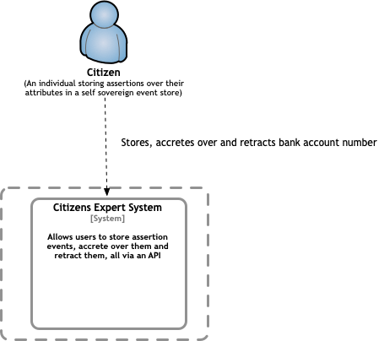
Illustrative Ecosystem Level 1 System Context Diagram

Slide 15
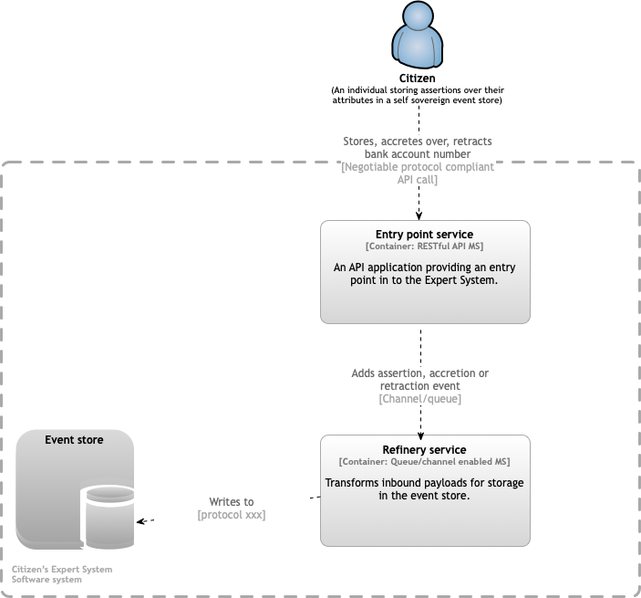
Illustrative Ecosystem Level 1 Container Diagram

Slide 16
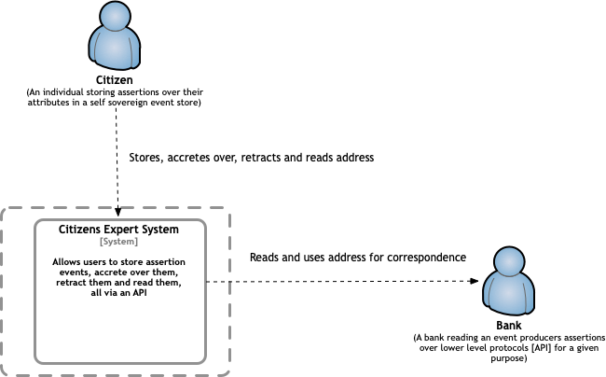
Illustrative Ecosystem Level 3 System Context Diagram

Slide 17
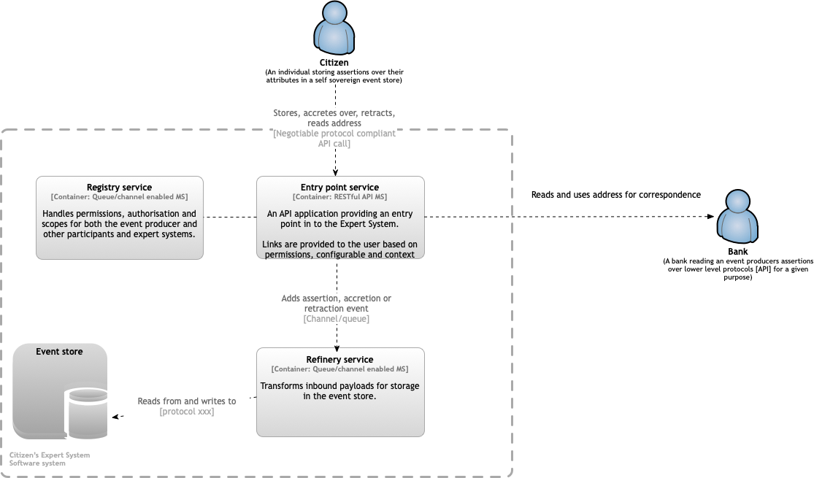
Illustrative Ecosystem Level 3 Container Diagram

Slide 18

Illustrative Ecosystem Level 4 System Context Diagram
Asserted relationship (“owner of”)
Identifiable artefact
(e.g. Land Register)
(An individual storing assertions over their relationship with an externally identifiable artefact)
Declares external artefact and asserts relationship
(Opaque) investigative process of asserted relationship
Allows users to declare the existence of an externally identifiable entity / artefact and assert a relationship
Attests to asserted relationship and (optionally)
details investigative process used
(A bank attesting to an asserted relationship based on an investigative process that may be opaque to the ecosystem)

Slide 19
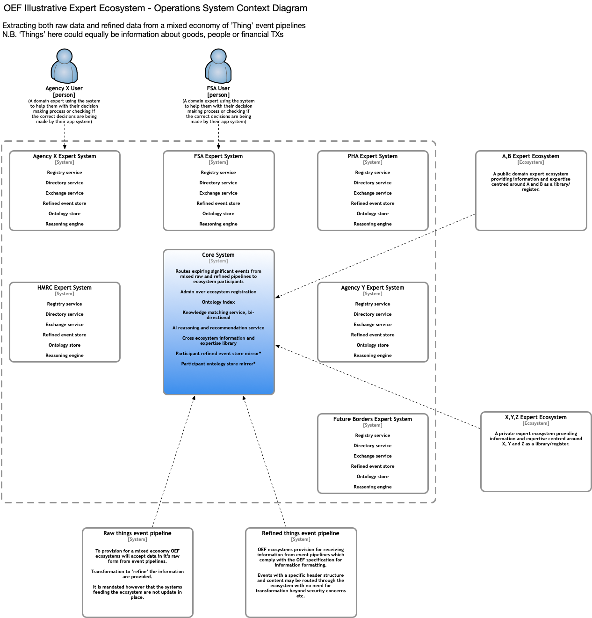
Illustrative Ecosystem Level [n] System Context Diagram

Slide 20
Responsibilities that MUST be represented in OEF ecosystems
Entry Point Service: at least one addressable API that provides access to the ecosystem
Refinery Service: to transform ‘raw’ data from external systems into OEF events
Event Pipeline: an external system generating data to be refined as events in the ecosystem
Event Store: a store for the refined events posted into the ecosystem by a participant
Registry Service: a record of ecosystem participants and their authorised scope of action
Directory Service: to facilitate discovery and matching between ecosystem participants
Exchange Service: to support information flow and value exchange between participants
Administration Service: to maintain shard artefacts critical to the operation of the ecosystem
Ontologies: conceptual models of the domain of interest shared by the ecosystem
Reasoning Engines: to derive insight and extract value from events in the ecosystem

Slide 21
Section 4
Target Use Case
Importing wine into the UK

Slide 22
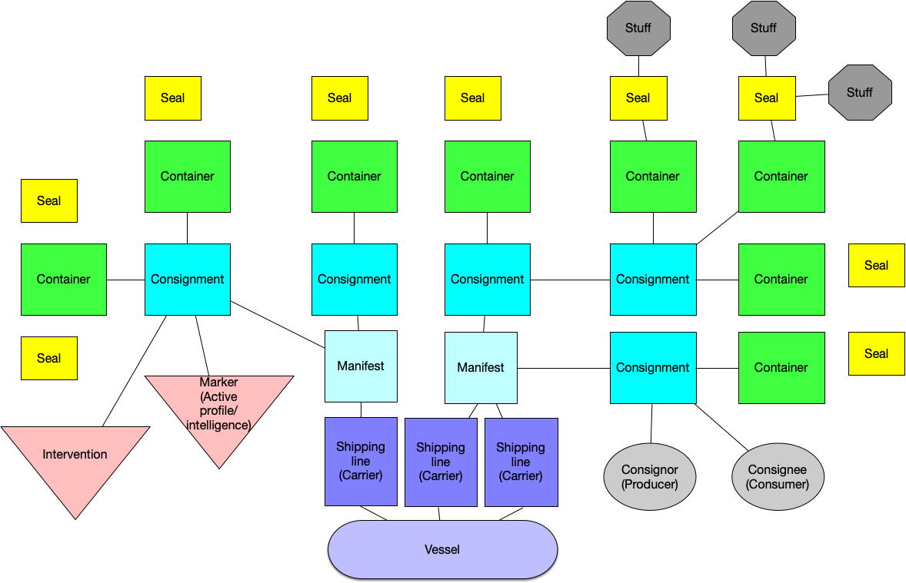
Domain knowledge – configuration of a ship

Slide 23
Domain knowledge – Event types
Use case specific events
Generalised events
Does the consignment originate from the country which it states it does?
Does the consignment contain what is stated on the manifest?
Does the freight forwarder/trader/importer/carrier have a history of (not) being stopped?
Does this freight forwarder / trader / importer / carrier have a history of imports which were "good“?
Has this freight forwarder / trader / importer / carrier been seen before?
Is this freight forwarder / trader / importer / carrier behaving in a way which is unusual?
How is this freight forwarder / trader / importer / carrier linked to others?
What has happened to this thing / person?
Is this thing / person the subject of this information set?
Does this information set represent this thing / person?
What is the source of this information set?
What is the relationship between this thing and that thing?
Is this the same thing as that thing?
What is the status of this thing?

Slide 24
Section 5
Q&A / AOB

